Slide 1
Hospital Management app
Presented by:
Bala Sai Krishna Gattineni
Emp Id: 2136794

Slide 2
CONTENTS:​
Project Review
Java​
Spring boot​
Spring boot Architecture​
Mongo DB​
Docker​
Swagger​

Slide 3
Project Review​
The Hospital management project is used to create and save the appointment of doctor and patient with prescription.​
Hospital management project having 3 services they are​
Doctor
Patient
Prescription
By using the Swagger website, we can create data and can get data by using credentials such as ​
Username​
Password​

Slide 4

Doctor
Doctors can find their appointments with details such as, ​
Appointment Id​
Patient name​
Doctor name​
Date of appointment and ​
Prescription Id ​ ​

Slide 5
Patient
Patients can find their appointments with details such as, ​
Appointment Id​
Patient name​
Doctor name​
Date of appointment and ​
Prescription Id ​ ​
​

Slide 6

Prescription
In Prescription, the every patient details will be stored in the prescription.​
Appointment Id​
Patient name​
Doctor name​
Description​
Prescription Id ​

Slide 7
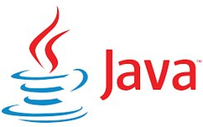
Java is a programming language and computing platform first released by Sun Microsystems in 1995.
Java is a class-based, object-oriented programming language designed for having lesser implementation dependencies. It is a computing platform for application development.

Slide 8

Spring is an open-source java-based framework used to create a micro service. It is developed by Pivotal Team and is used to build stand-alone and production ready spring application. ​

Slide 9
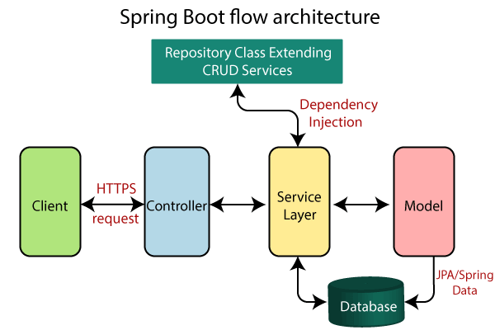

Slide 10

MongoDB is an open-source document-oriented database that is designed to store a large scale of data and allows you to work with that data very efficiently.​

Slide 11

Docker is an open-source containerization platform used for developing, deploying, and managing applications in lightweight virtualized environments called containers. ​

Slide 12

Swagger UI is one of the most popular tools for generating interactive documentation from your Open API document. Swagger UI generates an interactive API console for users to quickly learn about your API and experiment with requests.​

Slide 13


